Slide 1



TALA
Data Analytics and BI
ALY6060 Decision Support and Business Intelligence
Akshay Kirit Kalavadia, John DiSessa, Tianyu Ouyang, Szuyun Hao

Slide 2
01
Introduction
CONTENT
Industry 4.0
02
03
Data Analytics Culture
04
Global Initiative

Slide 3
Part I
Introduction

Slide 4

Introduction
TALA
A data science company that provides financing to customers through its mobile app.
- Founded in 2011 by Shivani Siroya, and is located in Santa Monica, CA, US.
- The current market capitalization is $750M, and has more than $350 million in investment.
- Serves millions of customers worldwide who have been overlooked by traditional financial institutions.
- The platform enables users to apply for a micro-loans ranging from $10 to $500 in emerging markets.

Slide 5
Part II
Industry 4.0
Interconnectivity, Big Data, & Machine Learning

Slide 6
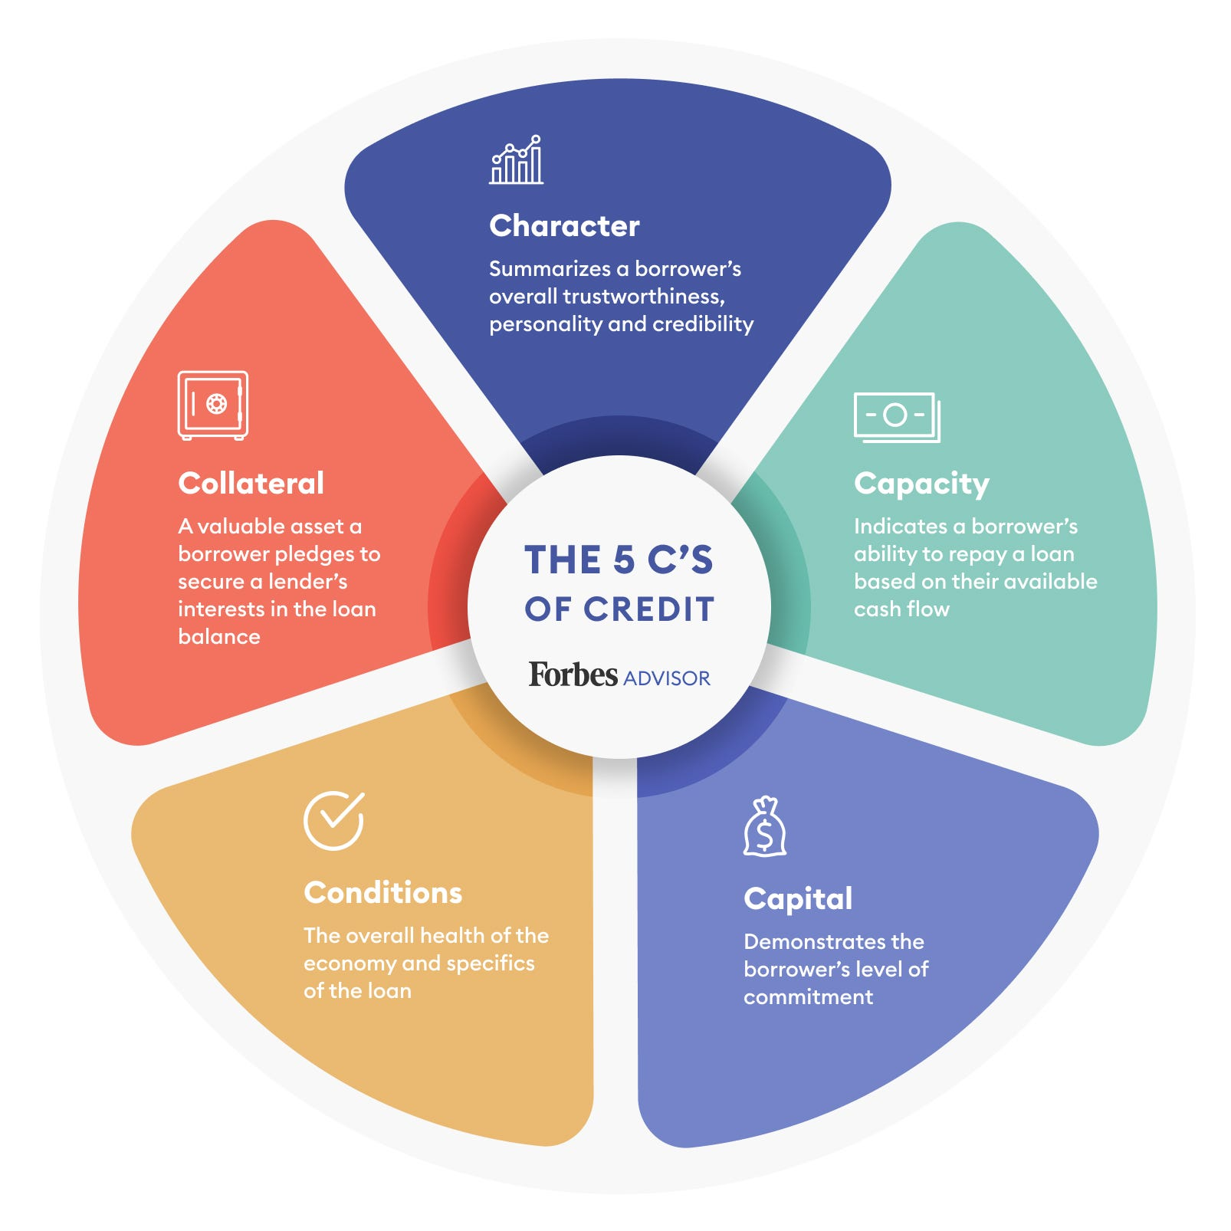
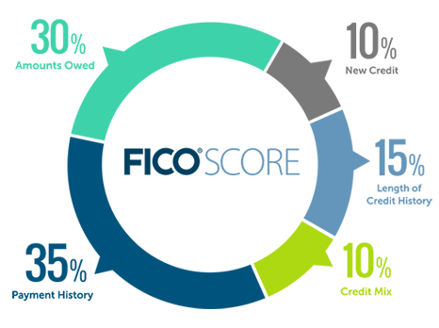
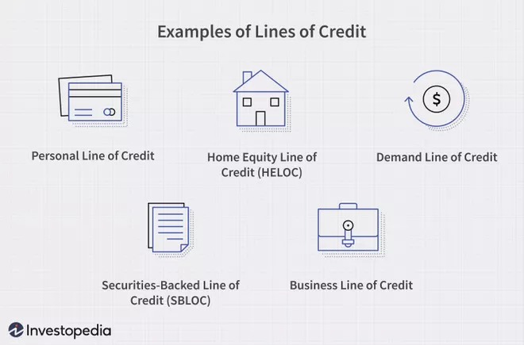
Industry 4.0
Problems With Traditional Credit
Evaluated on 5 only factors
Metrics change slowly over time
Disproportionately affects marginalized people
Poor people struggle to improve their lives without credit
Difficult to buy houses, cars, and education without credit
2 billion people worldwide are unbanked
Do not have access to traditional financial instruments

Slide 7
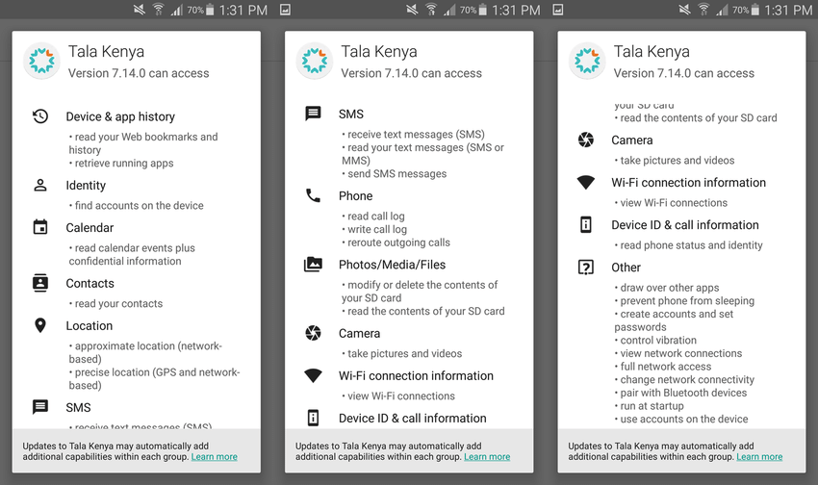
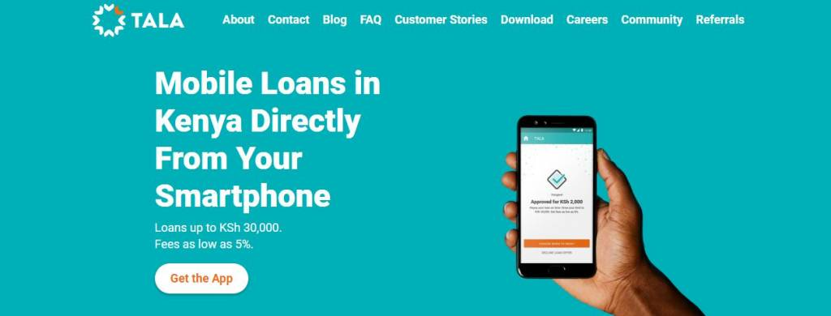
Industry 4.0
Big Data & Machine Learning
Customer routine habits are indicative of credit worthiness
10,000 data points tracked per customer and monitored in real-time
Texts, phone calls, app usage, social media usage, location history, etc.
Tala algorithm evaluates all criteria to determine credit worthiness
Decide whether to offer a loan or at what interest rate is fair for each customer
Congregates millions of customer data points to evaluate what is most correlated to repayment
Constant data collection increases accuracy and increases barrier to entry for competitors

Slide 8
Part III
Data Analytics Culture

Slide 9
Data Analytics Culture
Collect data with strict standardized dialogue and exceptional explanations about the usage and condition
Two Kinds of Data
Android device data
accurate information about the owner, the operating system, numbers of apps, and permission data
Behavioral data
location history, page lingering time, screen time, app usage
With the trend that people all around the world are anxious about data safety, Tala carries out strict permission procedures. Currently, the data usage is required to have allowance from the device owners with a standardized dialogue, and there will be additional explanations about the necessary data and where it will be used.

Slide 10
Data Analytics Culture
Without bias when gathering data and providing loans
Unlike traditional banks which enhance the importance of various factors, Tala holds the principle of giving everyone a chance and has built an automatic machine learning system that processes alternative information to identify credit scoring and determine the loan amounts. Those factors are naturally excluded from the judgements of the system.
Organizations with the strongest cultural orientation to data-driven insights and decision-making were twice as likely to have significantly exceeded business goals. Such operations help Tala expand business areas to Mexico, Philippines and India.
Nationalities
Gender
Religion
Race
Sexual Preference
Ethnicity
Medical history
Disability
Political views

Slide 11
Part VI
Global Initiative

Slide 12
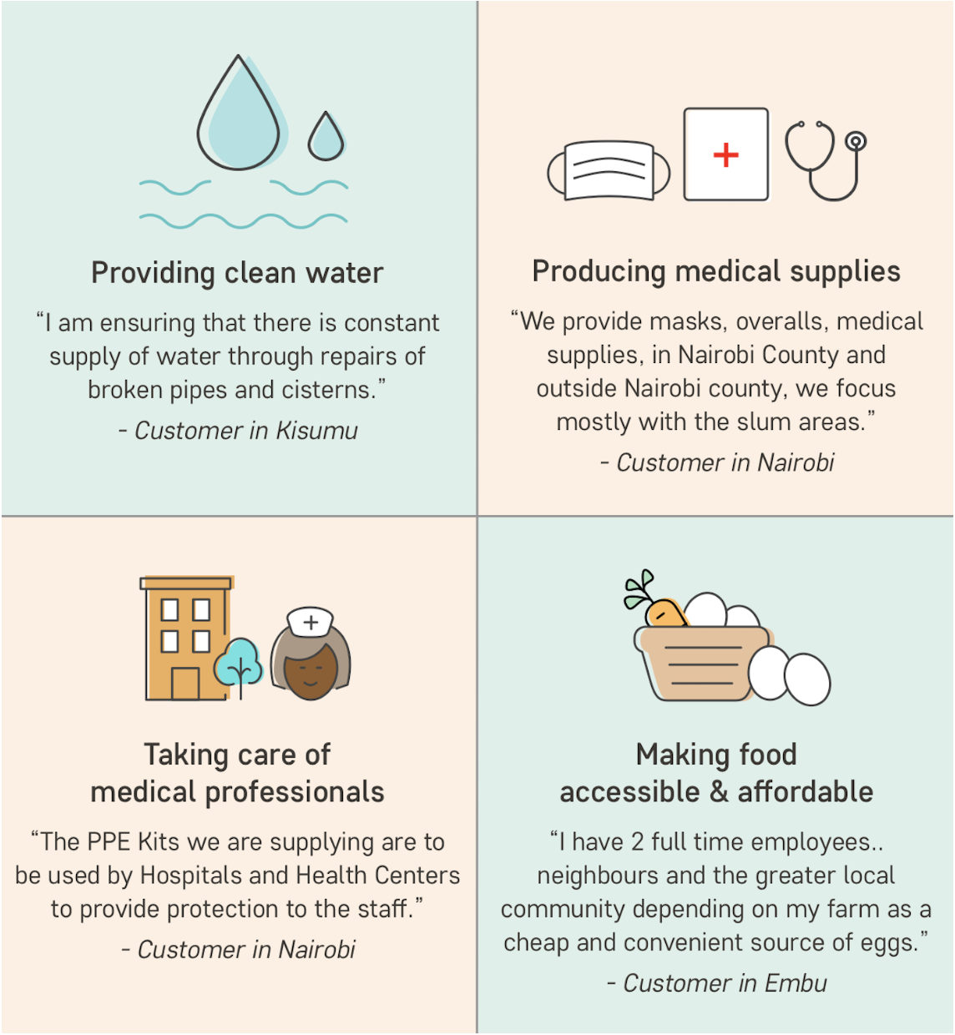
Global Initiative
Tala launches COVID-19 Rebuild Fund to support vulnerable communities
Tala has launched several Global Initiative to provide service to vulnerable communities in emerging markets.
Through the fund, Tala will directly provide small companies that provide needs like healthcare, food, education, and associated logistics with tailored 0% interest loans.`
Tala currently has following initiatives at global level:
Kenya COVID-19 Rebuild Fund
The Philippines COVID-19 Rebuild Fund
Mexico COVID-19 Rebuild Fund
Through the Tala Rebuild Fund, Tala is pleased to support some great clients who are using their loans to maintain and generate jobs while continuing to assist their communities in coping with COVID-19.

Slide 13

Conclusion
Leverage Big Data & Machine Learning
Provide micro-loans to underprivileged people in emerging markets
Track 10,000 data points per customer in real-time
Behavior is more indicative of credit worthiness than credit score
Loans without bias
Invest in communities

Slide 14
REFERENCES
Tala. (n.d.). TALA Reporting & Data Analyst. STARTUP.JOBS. Retrieved June 25, 2022, from https://startup.jobs/reporting-data-analyst-talamobile-3102055
Kene-Okafor, T. (2021, October 14). TechCrunch is part of the Yahoo family of brands. TechCrunch+. Retrieved June 25, 2022, from https://techcrunch.com/2021/10/14/tala-grabs-145m-to-offer-more-financial-services-in-emerging-markets/
tala company introduction - Zoeken. (n.d.). Craft. Retrieved July 2, 2022, from https://www.bing.com/search?q=tala+company+introduction&qs=n&form=QBRE&sp=-1&pq=&sc=0-0&sk=&cvid=1225BB4694A94C418369F412E89D4DE3&ghsh=0&ghacc=0
Tala. (2020, April 1). Tala launches COVID-19 Rebuild Fund to support vulnerable communities. Tala. Retrieved June 30, 2022, from https://tala.co/blog/2020/04/01/tala-launches-covid-19-rebuild-fund-to-support-vulnerable-communities/
https://www.slideshare.net/NguyenGiang102/how-tala-works-in-credit-score
https://www.myfico.com/credit-education/whats-in-your-credit-score
https://www.researchgate.net/figure/Tala-app-permissions-request_fig1_330266004
https://www.acuant.com/blog/the-worlds-unbanked-population/
https://www.forbes.com/advisor/credit-score/5-cs-of-credit/
https://www.investopedia.com/terms/l/lineofcredit.asp

